Slide 1

ISYS90118: Data Analysis
Rashika Bahl

Slide 2
Timeline for Research (Academia)
Research Design
Data Collection
Data Analysis
Project Scoping
Ethics Application
Recruitment
Literature Review
Write-up

Slide 3
Skills for IS Research and Development: Today’s Lecture
Qualitative Analysis
What is qualitative data?
Quantitative Analysis
What is quantitative data?
How do we analyse qualitative data?
Snippet examining quantitative data

Slide 4

What are characteristics of Qualitative Methods?
Key Words: Exploratory, Inductive, Interpretivist, Subjective
Purpose: To understand the phenomenon and richness of experiences within the context
Principle: Story Telling and Rich Data are important to explore the range of experiences rather than a summative approach to understanding a phenomenon or research question.

Slide 5

Qualitative Data: Rich but Messy
Qualitative Data is often in form of text, audio, or images, or just what you observe!
Richness:
Details and description of context, situation, feelings – with quotes and examples
Messy:
Covers different aspects of the phenomenon and may not be categorised easily on the same level of analysis, or even comparable within the study

Slide 6
Preparing Qualitative Data
Text and Audio: Transcribe
Music and Images: Describe and Check
Tone: Describe and Contextualise
Feelings: Describe and Contextualise

Slide 7
Qualitative Analysis: Let’s make sense of it all
Approaches (constructivist or interpretivist, or both)
Coding the data: Open, Axial, Selective
Counting Codes?
Rater and Inter-rater Reliability
Dealing with Level(s) of Analysis

Slide 8
Dealing with Level(s) of Analysis
Because qualitative data covers a wide range of topics and levels, it is likely that different readers might focus on different aspects of the data.
When to provide consistency? When to allow for inconsistency?

Slide 9
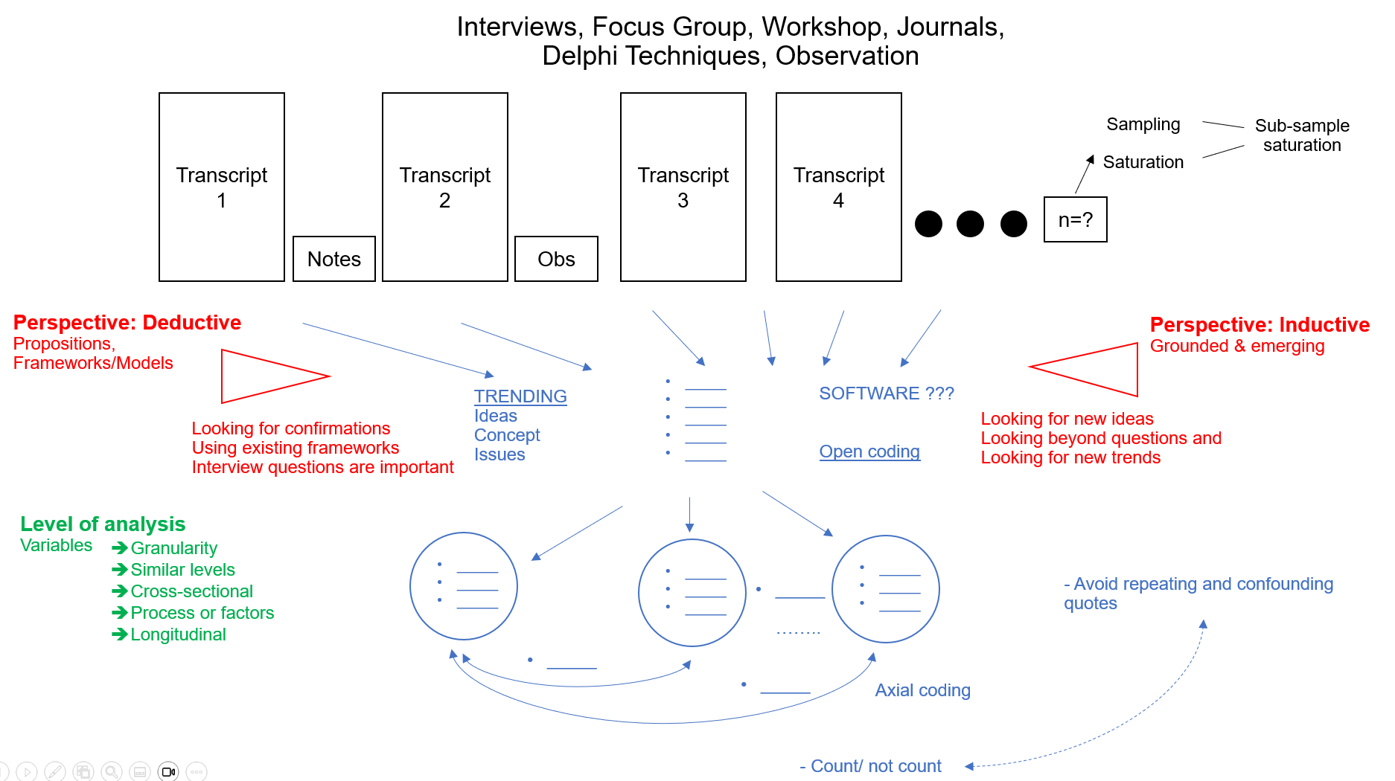

Slide 10
Exercise: Code this! And Compare!
Interviewer: As an employee, what was your experience with the new ‘Sellingforce’ software?
Respondent 1: It took some time to get used to it, and I needed time to learn how to use it to generate any useful report about my customers. Also it was not necessarily easy to understand how different customers were using our services at the start. However, after some more workshops and PD, I was able to use if better and it was really good to be able to track the behaviours of customers over time, though it was just about their purchase behaviour actually, not their decision making. That part is not well captured, hmmm… it makes me think maybe we need a way to capture what our customers’ preferences are but also we might know what they buy but we may not know why they buy it?
Anyway, when I look at what my other colleagues are doing, I think there is a bit of difference in how we are doing it and maybe we also need consistency in how we as a team use the system. You know what I mean? We are supposed to be one team. Anyway, overall, ummm… I think after the initial issues, I was able to use it quite well and efficiently.
Interviewer: Can you tell me a bit more about how the software impacted on your daily work?
Respondent 1: Well, because I have quite a huge customer base, I like to start the day by seeing what they have bought or any queries overnight. I like to be responsive if there are queries etc., right? So, I do tend to log in first thing in the morning, but honestly, sometimes, that can be distracting too because I end up being reactionary rather than doing some other work that is maybe more creative, I don’t know… maybe more strategic. But then, responding to immediate needs are also so important and since we have the data, why not do it, right? Hmmm. It’s changed and made me more busy in some ways because the creative work doesn’t go away, whereas in the past, I may not have the immediate data, so I would focus on the creative side, but now, I feel I have to respond to the data we have daily too. I think that’s a good thing but I am definitely more busy. Is that what management wants maybe, hahahah! So devious!

Slide 11
Rater and Inter-rater Reliability
Will the codes look similar if someone else if coding it with the same guidelines?
Why is this important in some contexts?
How would you check this?

Slide 12
Qualitative Analysis: Quality and Explainability
Confirmability - How do you give confidence to readers that the results are not just your opinions?
Credibility- Is it guided by literature, theory and conceptual work?
Credibility - Is it supported by clear evidence (e.g. quotes)?
Dependability - Is it making claims that cannot be substantiated and are quotes well interpreted?
Reflexivity - Is it well contextualised?
Reflexivity – Is the role of the researcher clarified?
Transferability – Will another group of respondents in the same context report similar results??

Slide 13
Qualitative Data Analysis Software
Nvivo
webQDA
Quirkos
Atlas.TI
Benefits: They can help with organisation and identify some simple patterns such as; how many? how often?
Limitations: QDAS do not actually analyse your data – they really help with organisation and counting words.

Slide 14

What are characteristics of Quantitative Research?
Key Words: Statistical, Confirmatory, Deductive?, Positivist, Objective?
Purpose: To understand the phenomenon through objective measures that try to be generalisable
Principle: To be objective and prove relationships

Slide 15
Quantitative Analysis: Let’s make sense of it all
Factor Analyses​
Multiple Regressions​
Comparative Stats​

Slide 16
So you’ve done a survey: preparing for analysis
Export from Qualtrics/Google Forms/Microsoft Forms/Survey Monkey
Remove incomplete entries
Ensure consistency of responses to scales (reverse any that need reversing)
Convert categorical demographic data into numerical values

Slide 17
So you’ve done a survey: preparing for analysis
Do you have enough participants?
Did you design your own instrument?
Do you have multiple-item scales?
What relationships are you interested in understanding?

Slide 18
Introduction to Factor Analysis
Helps validate constructs being measured
Exploratory: what is the possible structure of variables shaping the observable phenomenon?
Confirmatory: verifying structure of variables shaping the observable phenomenon

Slide 19
Quantitative Analysis: Validity and Generalisability
Content validity: are items representative of the phenomenon?
Face validity: are items interpretable by target population?
Criterion validity: how does the survey compare to other instruments used to measure the construct?
Construct validity: did the items measure the construct they intended to?
Reliability- Are each group of items interrelated and measure the same construct?
Generalisability – Can the instrument be used with other cohorts?

Slide 20
Quantitative Data Analysis Software
SPSS
R
Stata
Microsoft Excel
Benefits: Can make it easy to automate data analysis and data visualization tasks.
Limitations: Does not make a decision about what analysis is appropriate and whether your data is suited to your chosen analysis.

Slide 21
Working on Reflective Journal
Reflect on your Research Proposal writing experience
Reflect on the industry perspective videos of the subject
Reflect on how your view of research may has changed
Reflect on interesting theories or readings
Reflect on going to the museum and pitching last week
Reflect on preparing for upcoming pitch

Slide 22

Next Week
Rest!
Ice cream?

